Slide 1

Q&A with C#
#1: Properties
#2: Readonly vs Const

Slide 2

Properties in C#

Slide 3
Properties (introduction)
NOTE: Property is a wrapper around a field, which helps us (in C#) to organize methods typically used on fields => so called: “getter” and “setter”. In other words, a property is not a new magic member introduced in C#, but just a syntax sugar to an already existing fundamentals.
According to OOP and SOLID principles, fields should be used locally only by the class or method where they are defined. To use field from outside, we should follow encapsulation rule and for private or protected fields (sometimes in rare cases we need to use protected fields) we are creating an additional public, internal or protected methods to Set a value there or to Get a value from there. Properties are helping us with this by sparing the additional amount of code to write. Of course, using public field is possible, but it breaks encapsulation rule. It’s like drying your laundry on a balcony. Possible? Yes. Aesthetic and well-mannered? No…
https://docs.microsoft.com/en-us/dotnet/csharp/programming-guide/classes-and-structs/properties

Slide 4

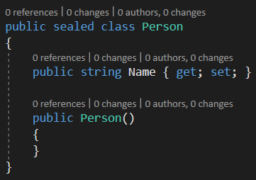
Property in the IL code
In the Intermediate Language (IL) code the C# Property will be translated into a field (so called: “backing field” => which means: “the field used by property”) with defined Get and Set methods

Slide 5
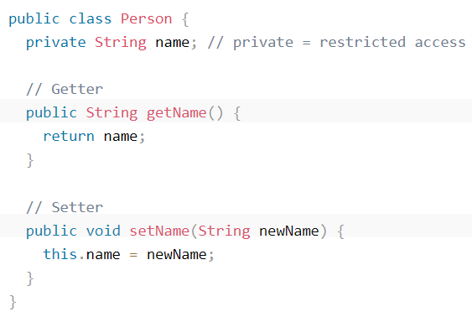
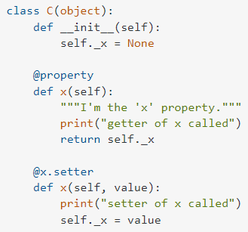
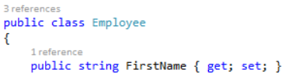
The world without Properties
Java:
Python:
C#:

Slide 6
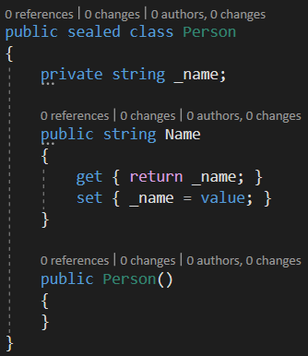
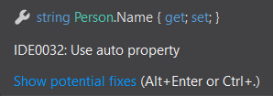
Different types of Properties
Auto Property
Full Property
- Regular field (not following naming convention _age, and OOP encapsulation rule. Distinction is more difficult)
- Backing field is “hidden” (implicit) - Default Get and Set methods
- Backing field is visible (explicit) - Default Get and Set methods

Slide 7
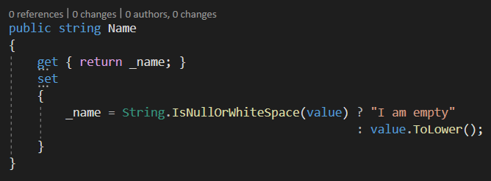
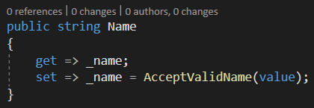
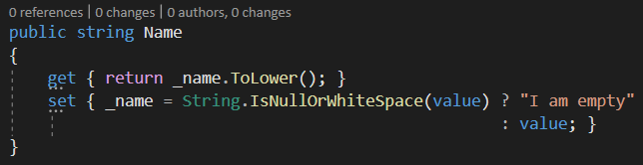
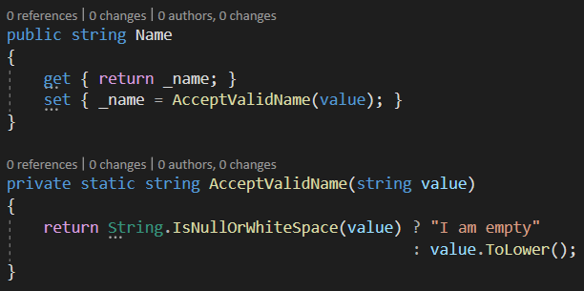
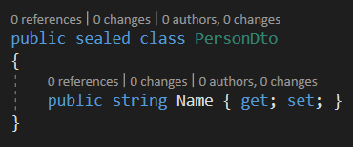
Custom Get and Set methods
Full body methods
Expression body methods
HINT #4: If this is allowed in your project (code guidelines)
you may propose even further cleanup and convert older C# syntax into a expression bodies (they look like lambda) and were introduced with C# 6
HINT #1: There is a “good practice” rule, to not modify the get method. Get should be as simple as possible, and only return the stored value. Here, our Get method is changing the original value (ToLower()) which may be misleading when using this code later
HINT #2: In specific cases (like POCO or DTO models) some developers may suggest that either Set nor Get method should do nothing => this is responsibility of someone else to parse the values into a desired ones
HINT #3: If the method body is complex or too large it is worth to extract it into a separate method for clarity

Slide 8
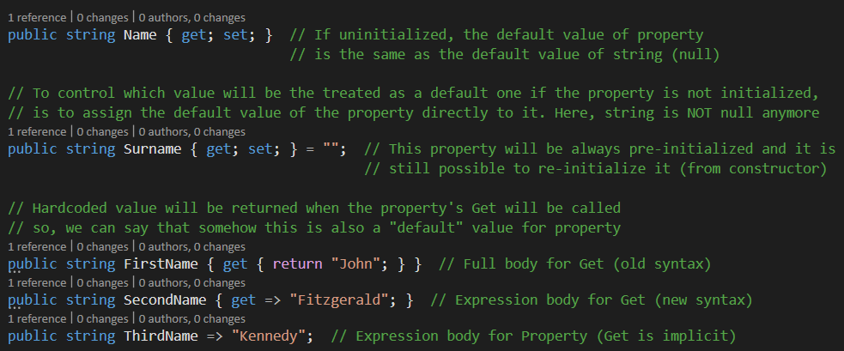
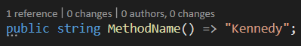
Default values of Properties
PS: You can also use expression body for methods (acceptable solution if they are very short)

Slide 9
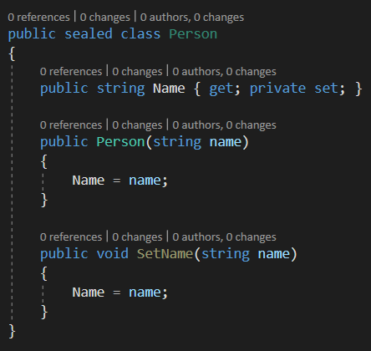
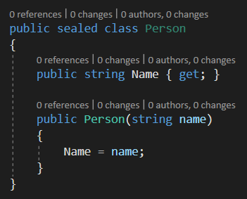
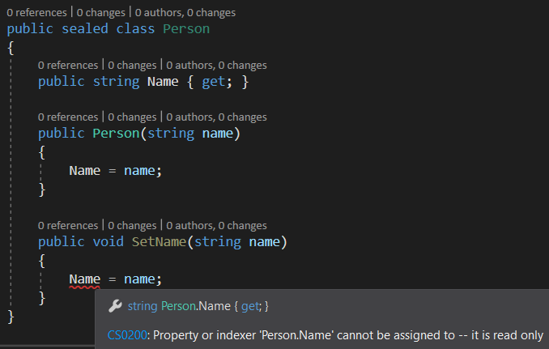
Access modifiers in Properties #1
And if you remove setter entirely (don’t worry C# compiler will create it in IL code anyway) you will achieve super safe class with Name property being able to initiali- ze only from the class constructor!
In this case, both Get and Set methods are inheriting the public access modifier from the main Property
In this case, Set method was marked as private and cannot be used anymore from outside. Which means, that Name property is more secure, since it can be initialized only from constructor or from the local class logic (SetName() method)
Of course, you should use access modifiers extensively, following the rule to always prefer the minimum possible accessibility (if you are not using YET your property’s Set somewhere else – mark it as private). Consider using protected modifiers to improve your encapsulation if the class can be inherited, or for example internal – to allow accessing this member or method only from the current assembly (project), but not solution-wide. We have also new private protected and protected internal modifiers from C# 7.

Slide 10
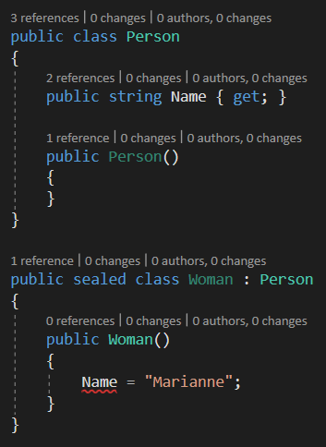
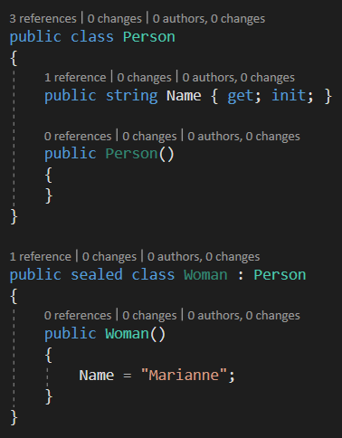
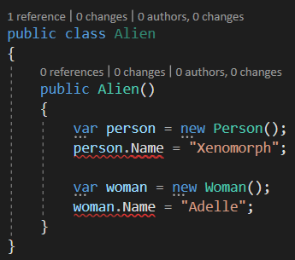
Access modifiers in Properties #2
Even more advanced technique is to replace missing set keyword by a new (C# 9) init keyword!
Before, it wasn’t possible to initialize this “super-safe” property from deriving class
And which is still protecting the spe- cific property from being modified from an “unauthorized scope”
Microsoft decided however that this is it too restrictive!
And the new init keyword was introduced, which is giving us the flexibility to initialize property from an inheriting class (it’s trusted!)

Slide 11

Readonly vs Constant

Slide 12
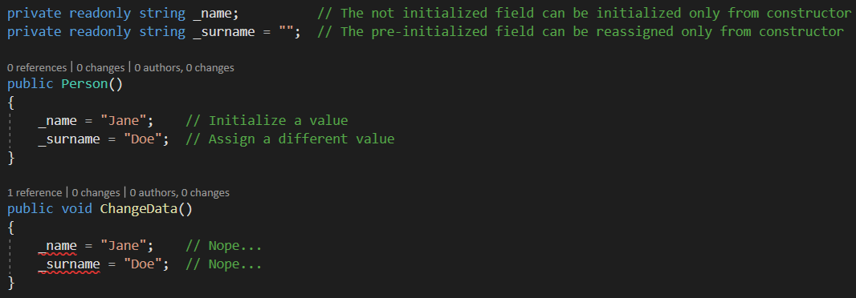
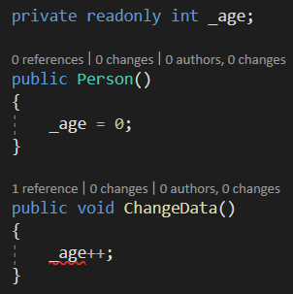
Readonly vs Constant fields #1
Just like Properties, fields can be also not initialized (then, the default value of value type or reference type is used), pre-initialized, and/or protected from being re-initialized once again
We are using the benefit of “readonly” behavior if we want to ensure that when the class will be created the internal members (such as fields) will be always initialized with spe- cific values and that nobody else can change them later

Slide 13

Readonly vs Constant fields #2
Readonly members: - fields - structs - properties (with init or removed set)
Constant members: - fields
However, a static readonly value of member will behave just like a regular readonly one AND (bonus) will be created in compile-time
Lifetime: - readonly initialization is happening during runtime (when the specific code is executed)
Lifetime: - constant initialization is happening during compile-time (when the code is compiled; then, in IL code, value will be “stamped”)
All constants are static by default

Slide 14
Reason to use
1. Data control
Encapsulation (the data can be changed only from a specific scope, especially useful if combined with access modifiers)
Data protection (controls when and whether at all a specific data can be changed)
Data consistency (ensure to preserve some state of data during program lifetime)
2. Maintenance
Clarity for other developers (what is the purpose of a specific data in the code)
Accessibility (some data can be reused from different places. It’s quite common that some important and universal constants are shared as public)
3. Performance
In real-time something is created (allocated in RAM) on demand – only when needed. However, this may lead to an additional microscopic slowdown of the program (large/many objects).
In compile-time something is created (allocated in RAM) immediately. No further effort is needed. However, more RAM will be consumed in advance, even if this data is not going to be used/soon.

Slide 15
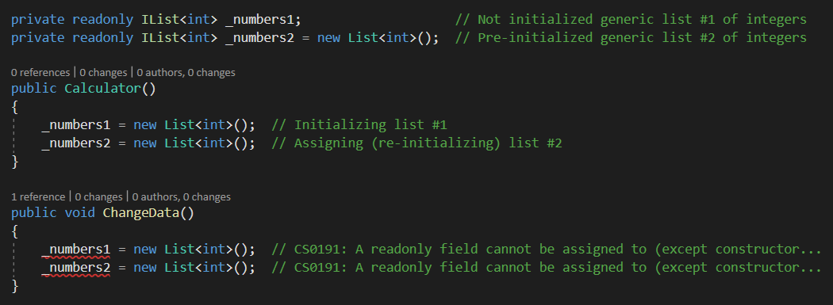
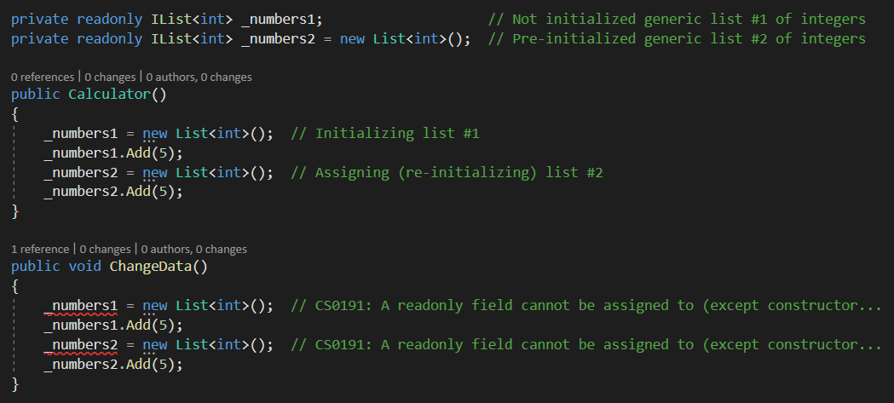
Who is readonly here?
This is still possible because you are not assigning a new List to readonly variable, only changing the elements inside an already existing collection
This is still possible because you are not assigning a new List to readonly variable, only changing the elements inside an already existing collection

Slide 16
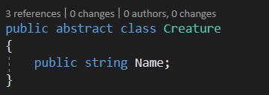
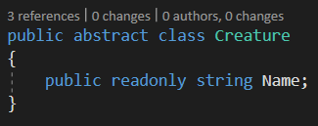
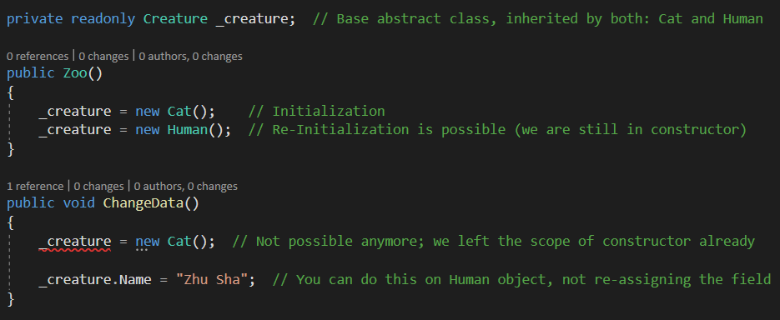
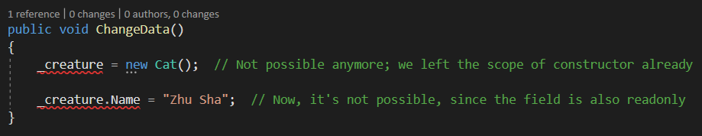
Who is readonly here?

